Slide 1
The Transport Layer
Introduction

Slide 2
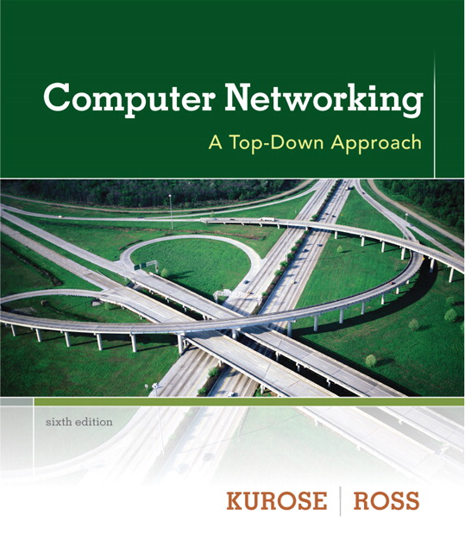

Chapter 3 Transport Layer
Computer Networking: A Top Down Approach 6th edition Jim Kurose, Keith Ross Addison-Wesley March 2012
A note on the use of these ppt slides:
We’re making these slides freely available to all (faculty, students, readers). They’re in PowerPoint form so you see the animations; and can add, modify, and delete slides (including this one) and slide content to suit your needs. They obviously represent a lot of work on our part. In return for use, we only ask the following:
If you use these slides (e.g., in a class) that you mention their source (after all, we’d like people to use our book!)
If you post any slides on a www site, that you note that they are adapted from (or perhaps identical to) our slides, and note our copyright of this material.
Thanks and enjoy! JFK/KWR
All material copyright 1996-2013
J.F Kurose and K.W. Ross, All Rights Reserved

Slide 3

















Transport services and protocols
application
transport
network
data link
physical
provide logical communication between app processes running on different hosts
transport protocols run in end systems
send side: breaks app messages into segments, passes to network layer
rcv side: reassembles segments into messages, passes to app layer
more than one transport protocol available to apps
Internet: TCP and UDP
logical end-end transport
application
transport
network
data link
physical

Slide 4
Transport vs. network layer
network layer: logical communication between hosts
transport layer: logical communication between processes
relies on, enhances, network layer services
household analogy:
12 kids in Ann’s house sending letters to 12 kids in Bill’s house:
hosts = houses
processes = kids
app messages = letters in envelopes
transport protocol = Ann and Bill who demux to in-house siblings
network-layer protocol = postal service

Slide 5
Internet transport-layer protocols
reliable, in-order delivery (TCP)
congestion control
flow control
connection setup
unreliable, unordered delivery: UDP
no-frills extension of “best-effort” IP
services not available:
delay guarantees
bandwidth guarantees
application
transport
network
data link
physical
network
data link
physical
network
data link
physical
network
data link
physical
logical end-end transport
network
data link
physical
network
data link
physical
network
data link
physical
network
data link
physical
application
transport
network
data link
physical

